Slide 1
School of Computer Science Engineering & Information Science A Report on mini-Project :- Admission Management
Course Name:- Web technologies
Course Code:- CSE2258 Date Of Submission:- 21/11/2025
Students Name:- Diwakar Goswami, 20241IST0100
Manoj Kumar, 20241IST0098
Lithin, 20241IST0097
Priyanka, 20241IST0099
Aqram, 20241IST0096

Slide 2
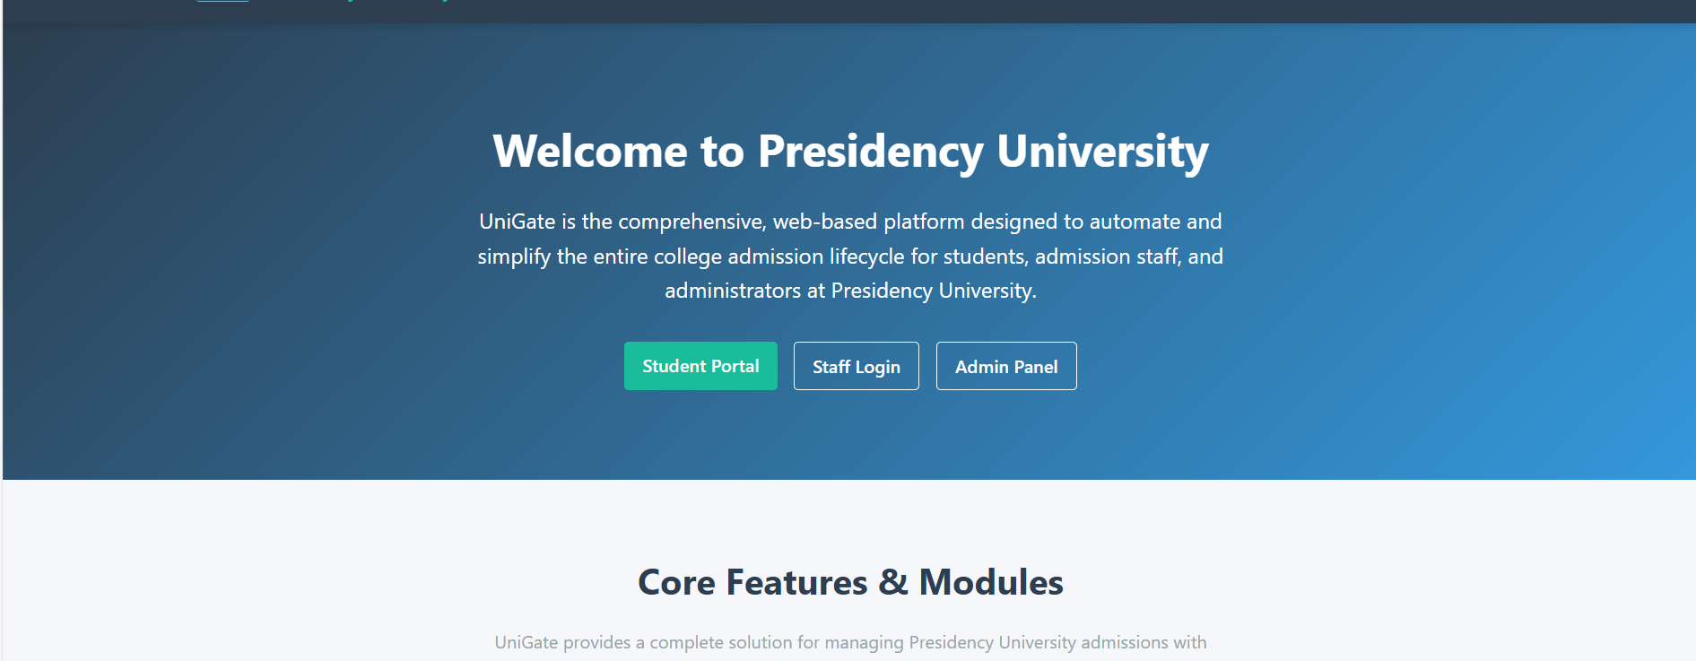
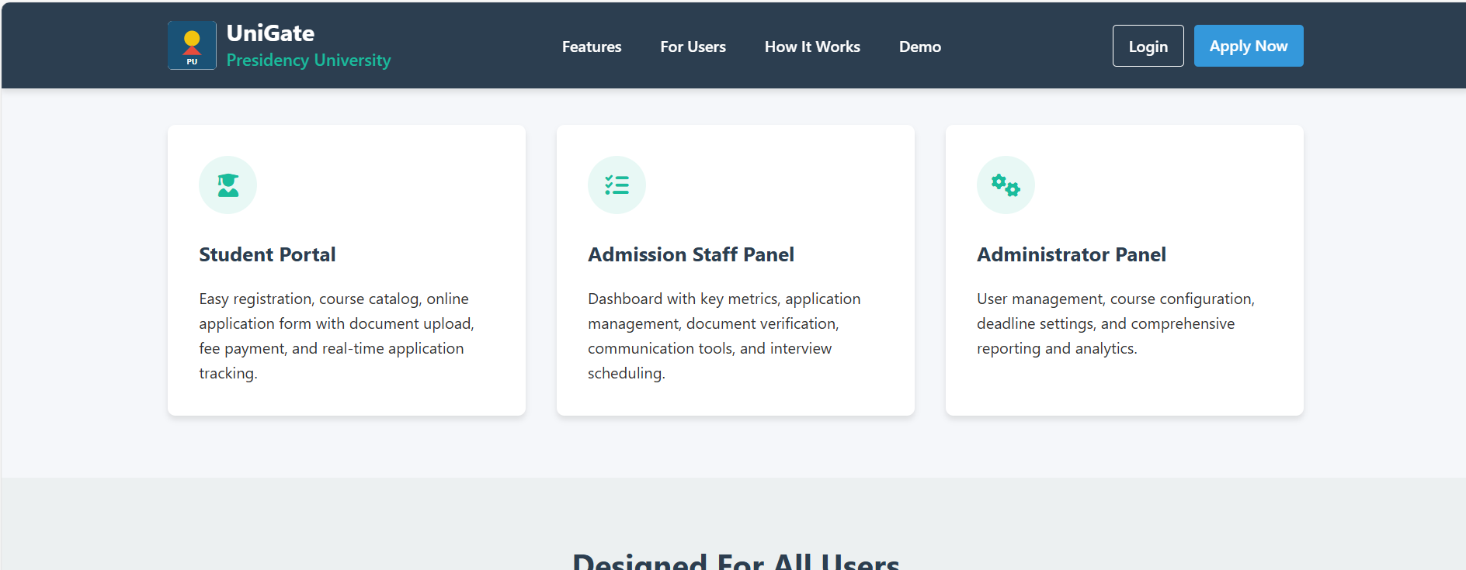
Sample Output of Web Page

Slide 3
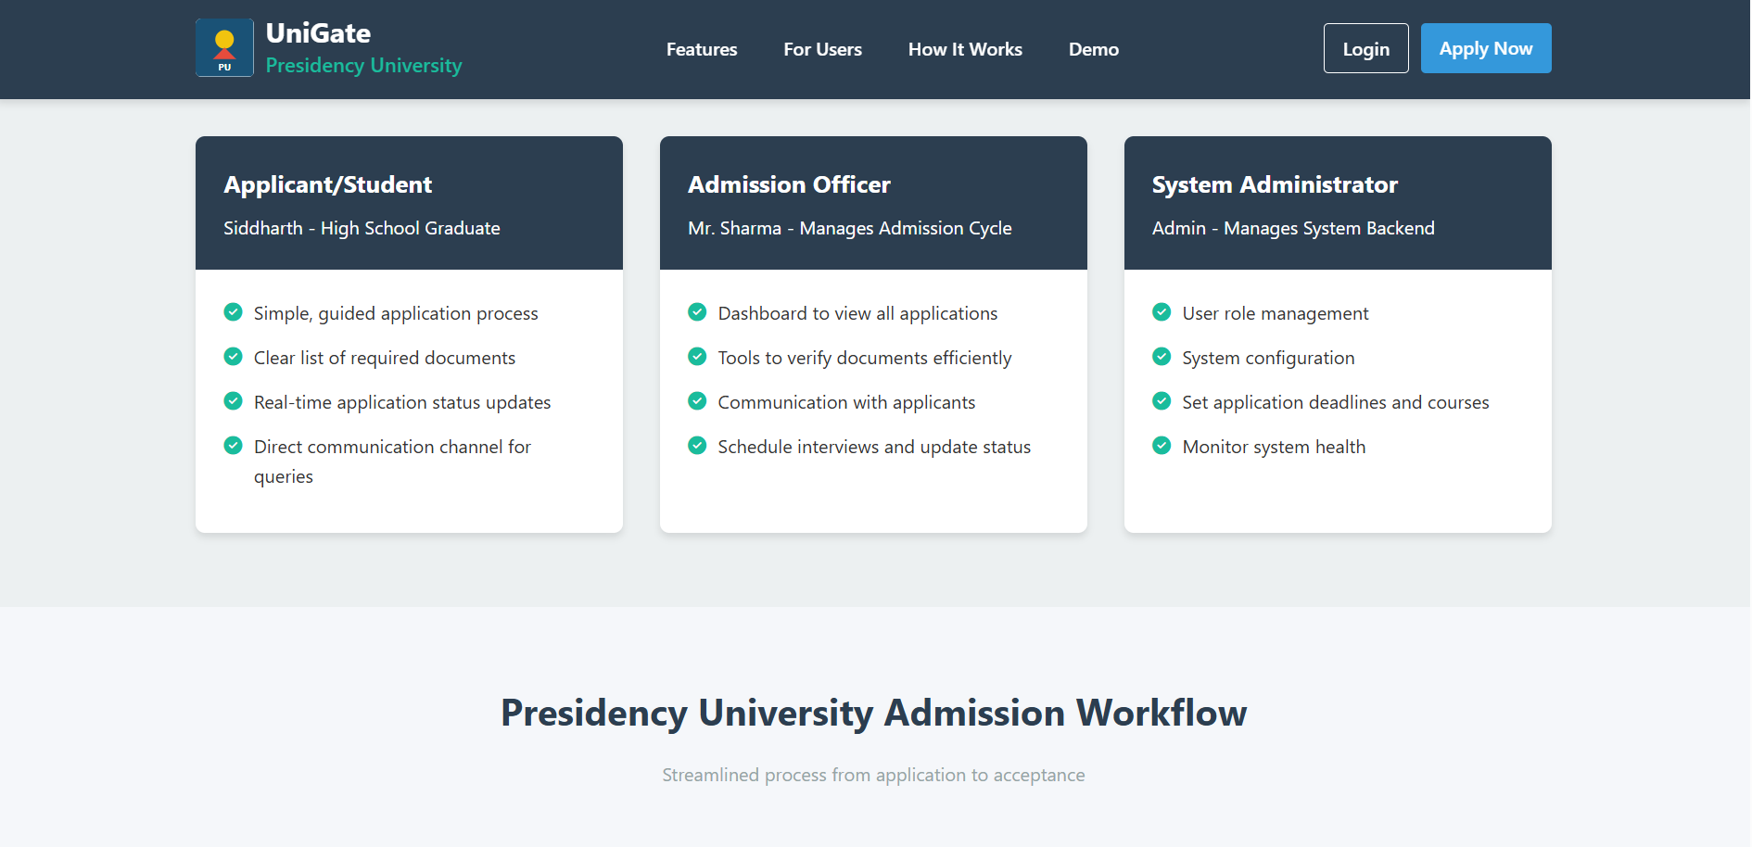
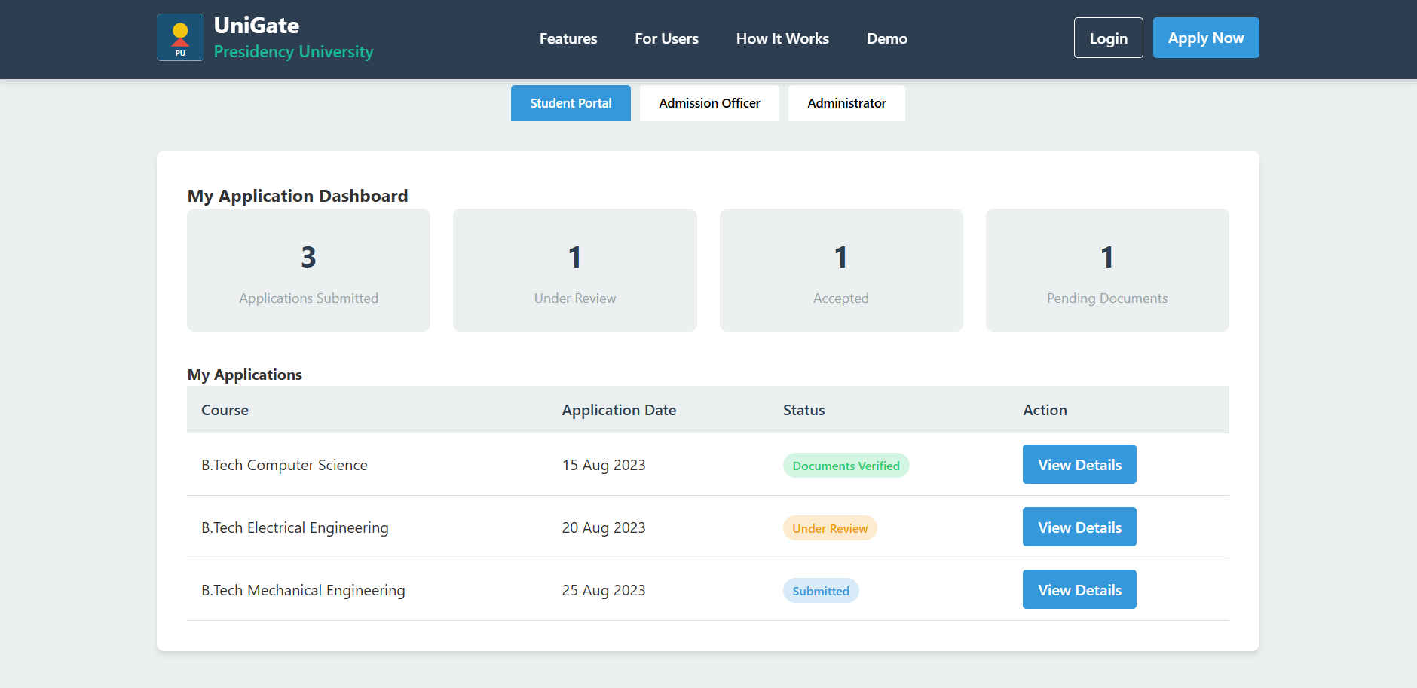
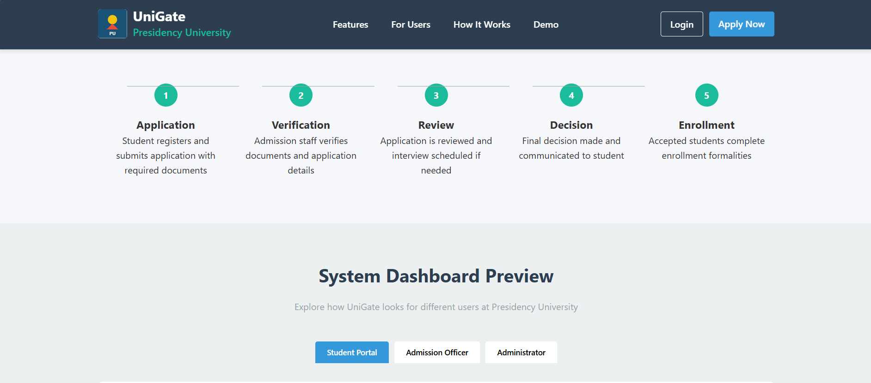

Slide 4


Slide 5
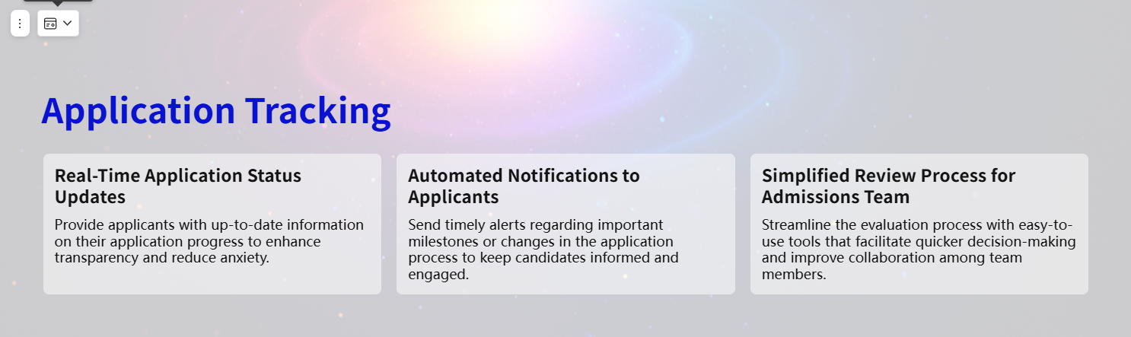

Slide 6


Slide 7


Slide 8
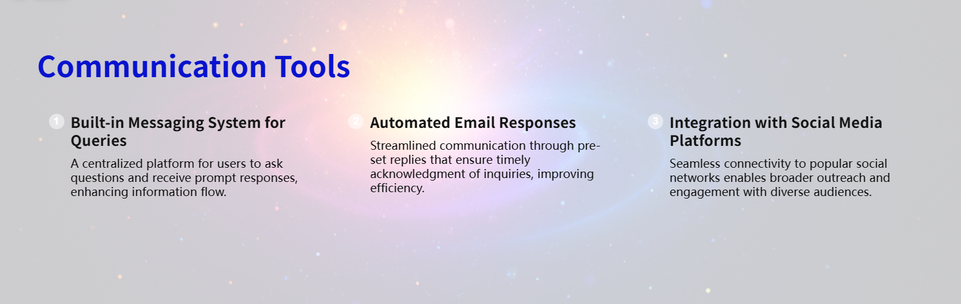

Slide 9
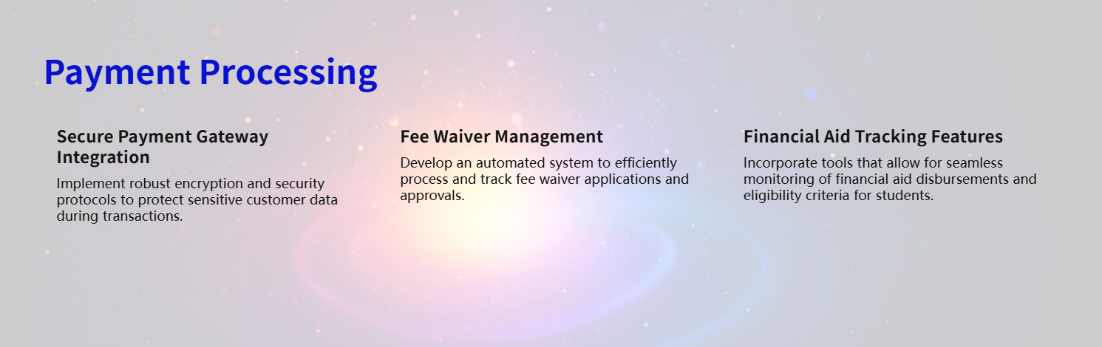

Slide 10


Slide 11


Slide 12


Slide 13


